Slide 1
Introduction of Next-Generation Sequencing
09/06/2024
Dr. Luu Phuc Loi (luu.p.loi@googlemail.com)

Slide 2
Content
Human Genome Project (HGP)
Next-Generation Sequencing (NGS)
Short read vs Long read
NGS Applications

Slide 3


Human Genome Project - HGP (Oct 1990 - April 2003)
In 2003, the Human Genome Project produced a genome sequence that accounted for over 90% of the human genome (~3 GB).
It was as close to complete as the technologies for sequencing DNA allowed at the time.
Cost ~3 billion US$
=> Facilitating advancements in next-generation sequencing (NGS) technologies
HGP Paper
Venter/Celera Paper
https://www.genome.gov/human-genome-project

Slide 4
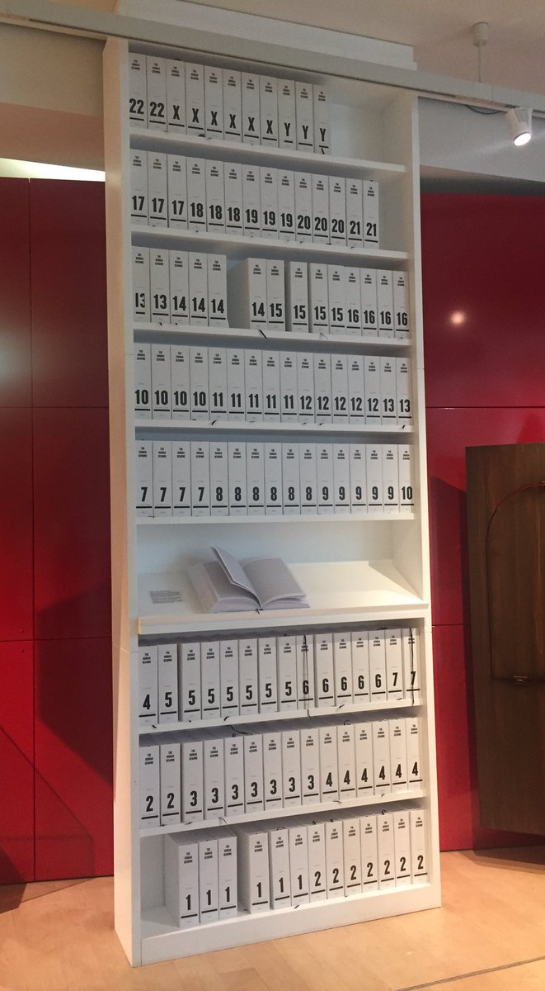
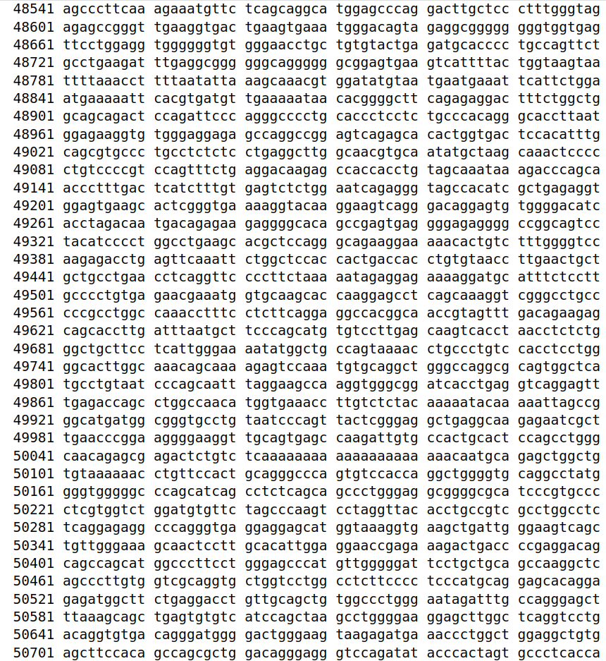
https://www.ncbi.nlm.nih.gov/nuccore/806904736

Slide 5
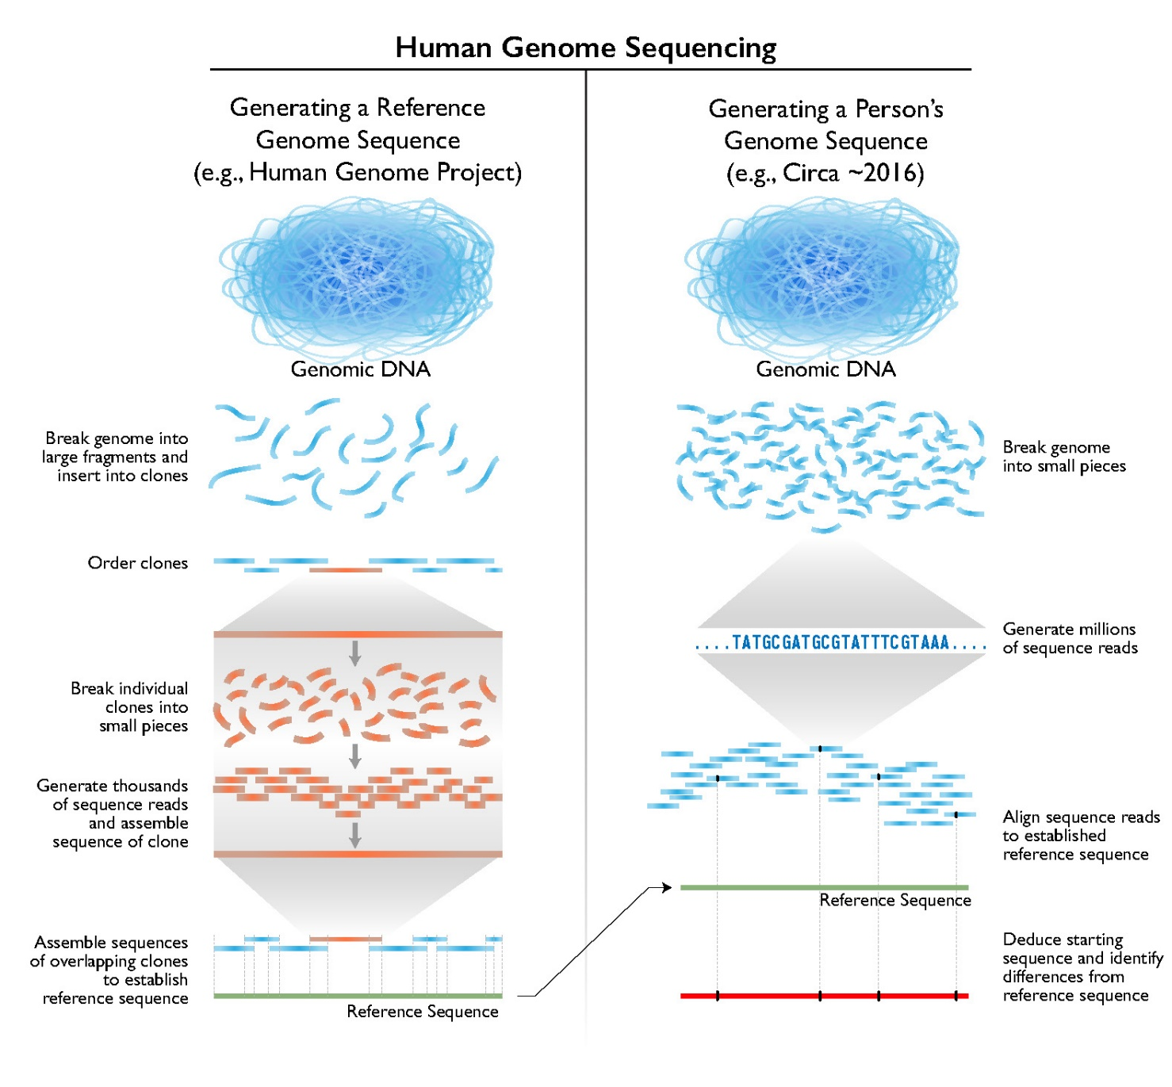
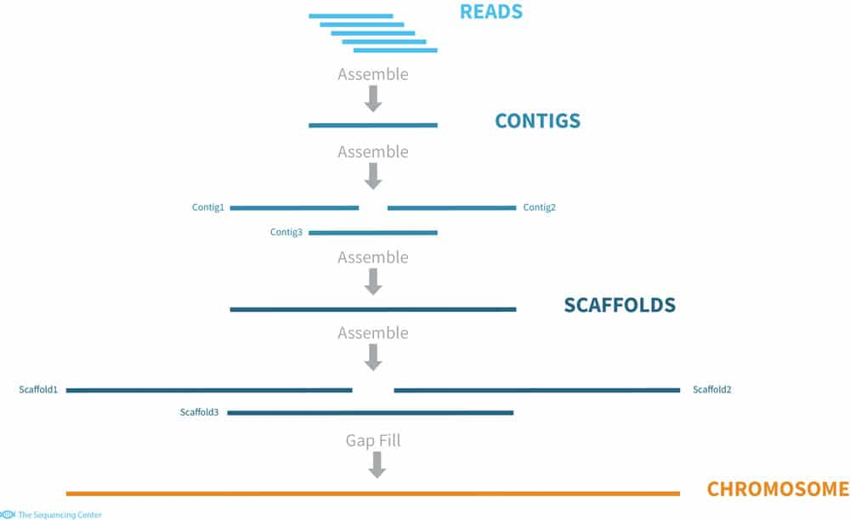
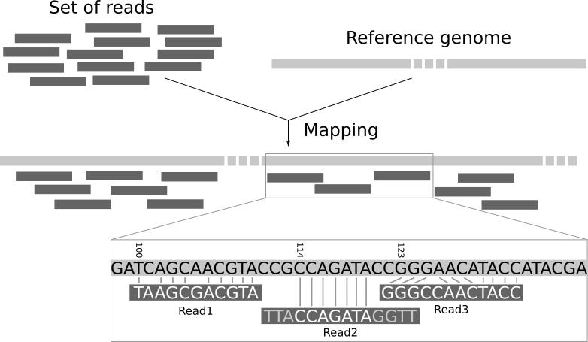
Next-Generation Sequencing (NGS): Reference Genome
De novo assembly
Mapping to reference
https://www.genome.gov/about-genomics/fact-sheets/Sequencing-Human-Genome-cost

Slide 6
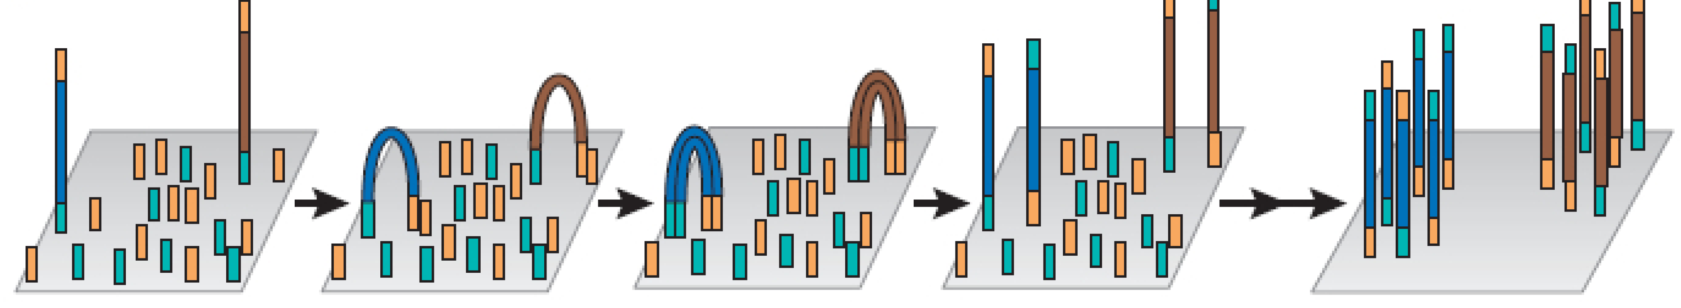
NGS: 1) Parallel Sequencing
10.3390/medsci2020098

Slide 7


NGS: 2) Reference Genome
De novo assembly
Mapping to reference
https://www.genome.gov/about-genomics/fact-sheets/Sequencing-Human-Genome-cost

Slide 8
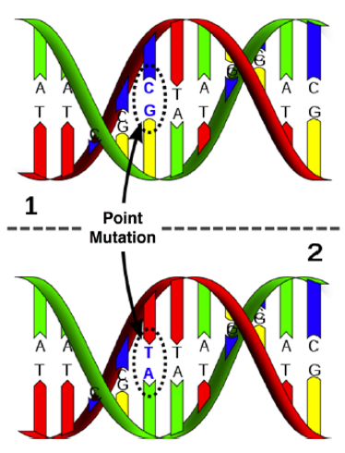
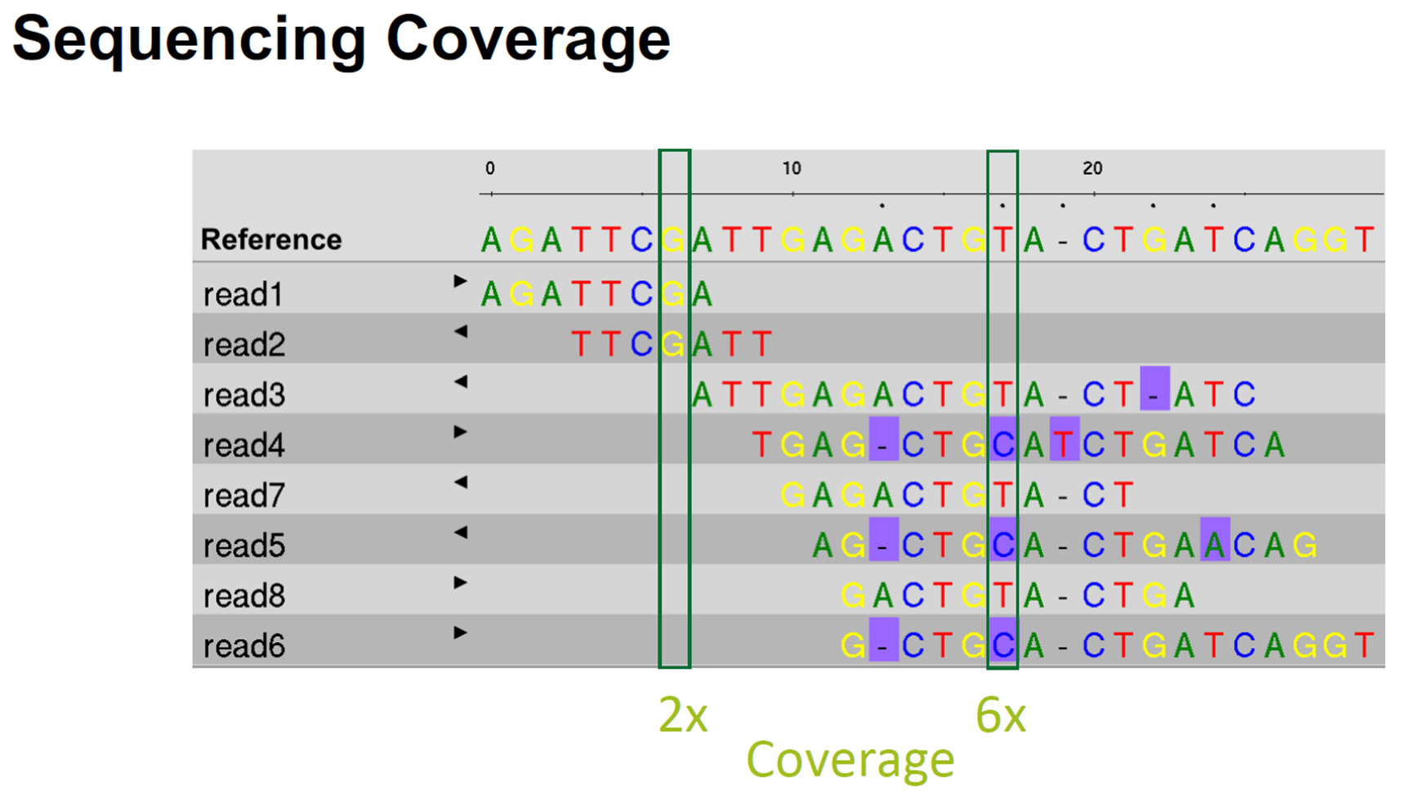
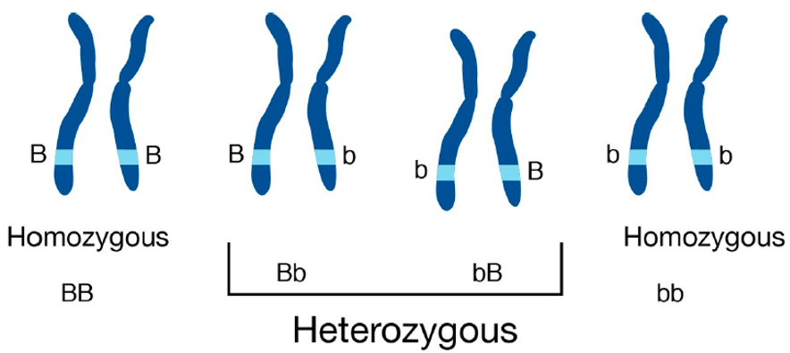
Human Genome Variation
Human genomes are > 99% similar by sequence
A typical human genome has ~ 5 million variants with 3-4 million single nucleotide variants
Humans are diploid

Slide 9
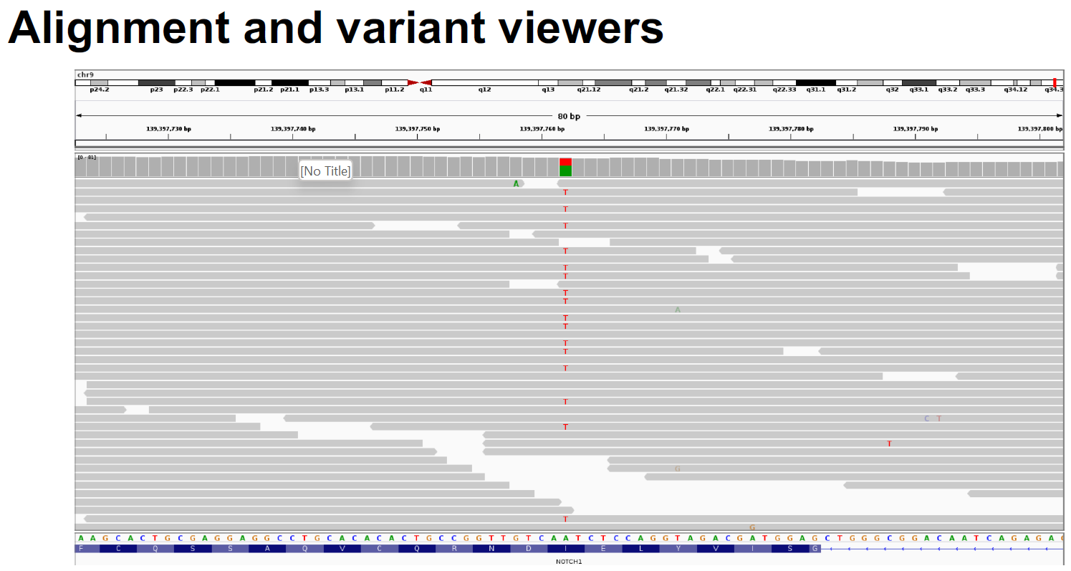

Slide 10
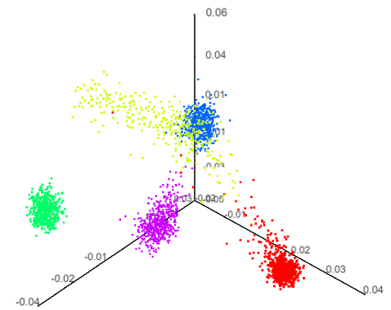
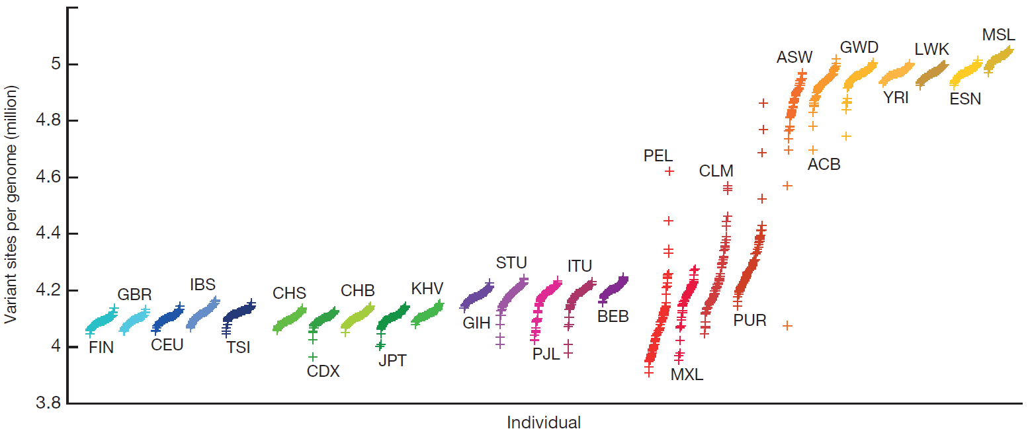
Human Genome Variation: 1000 Genomes Project
Admixed American
European
African
East Asian
South Asian
The number of variant sites per genome of 1K human genomes project (2015) Kinh in Ho Chi Minh City, Vietnam (KHV)
doi:10.1038/nature15393

Slide 11
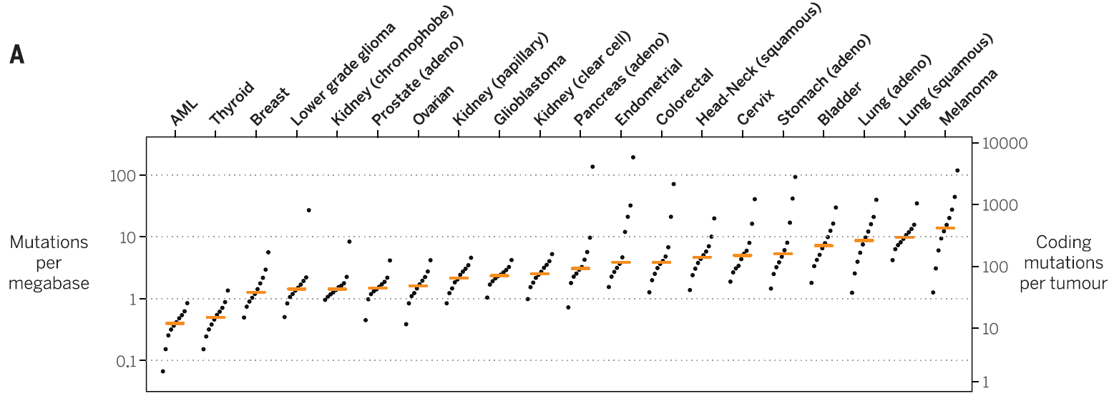
Cancer Genome Somatic Variation
Mutation burden in 20 tumor types and relative contribution of different mutational processes.
For each tumor type, samples were divided into deciles on the basis of their mutation burden. (2015)
DOI: 10.1126/science.aab4082

Slide 12
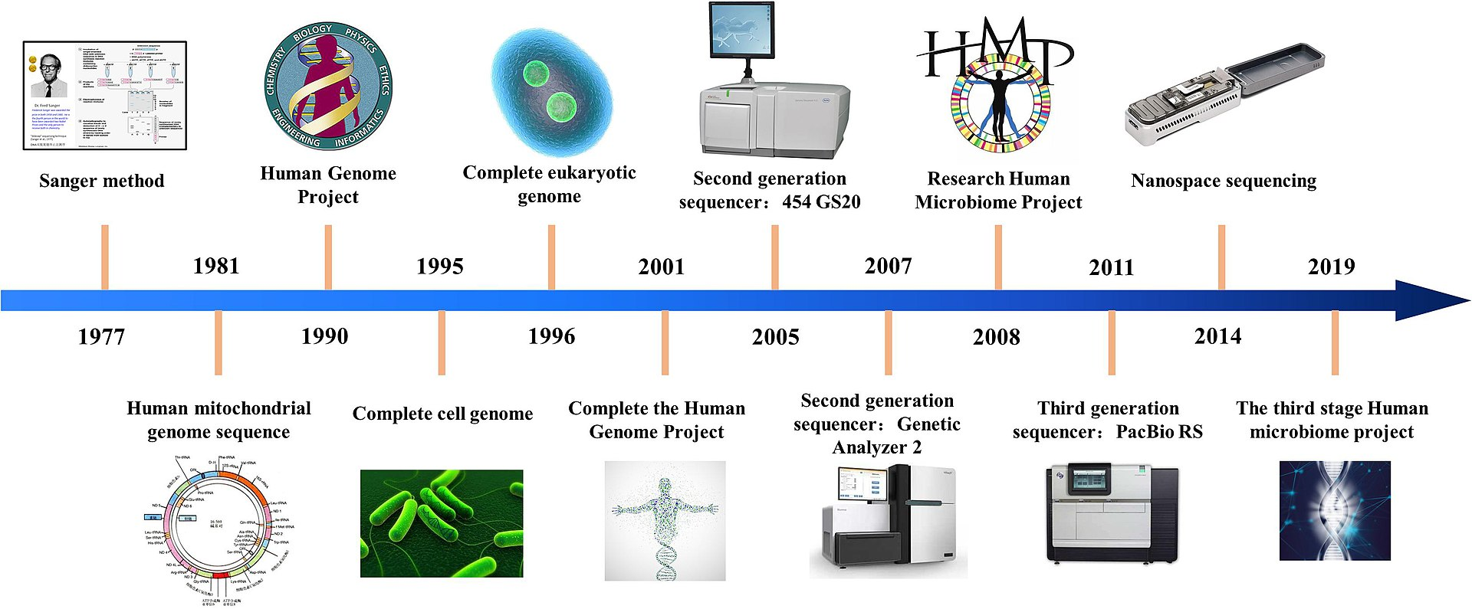
High-throughput sequencing (HTS) methods
https://en.wikipedia.org/wiki/DNA_sequencing

Slide 13
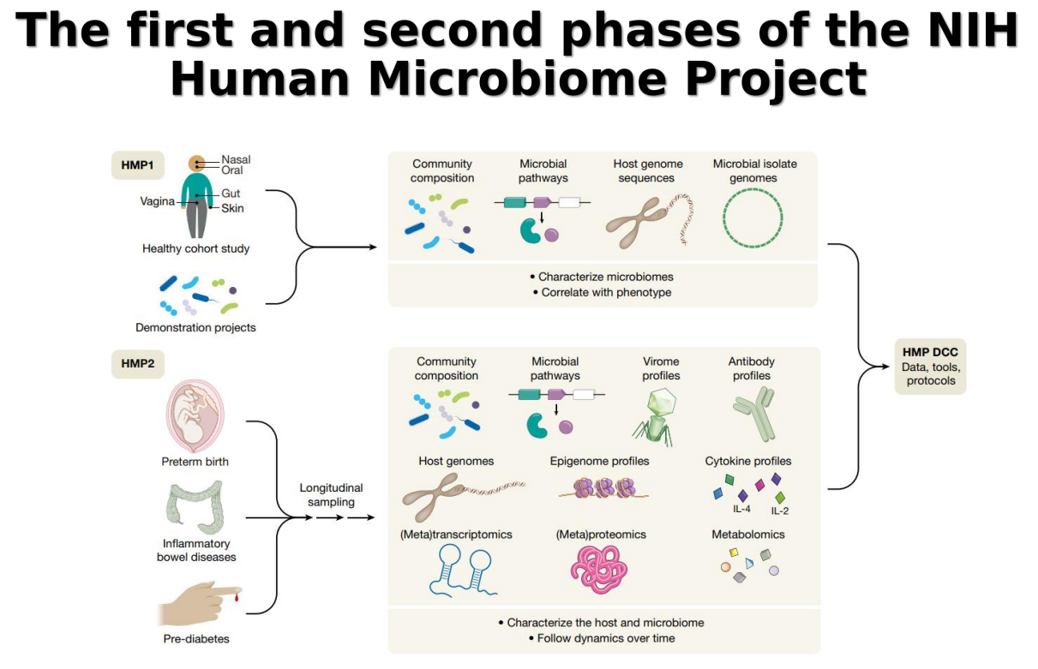
https://www.nature.com/articles/s41586-019-1238-8

Slide 14
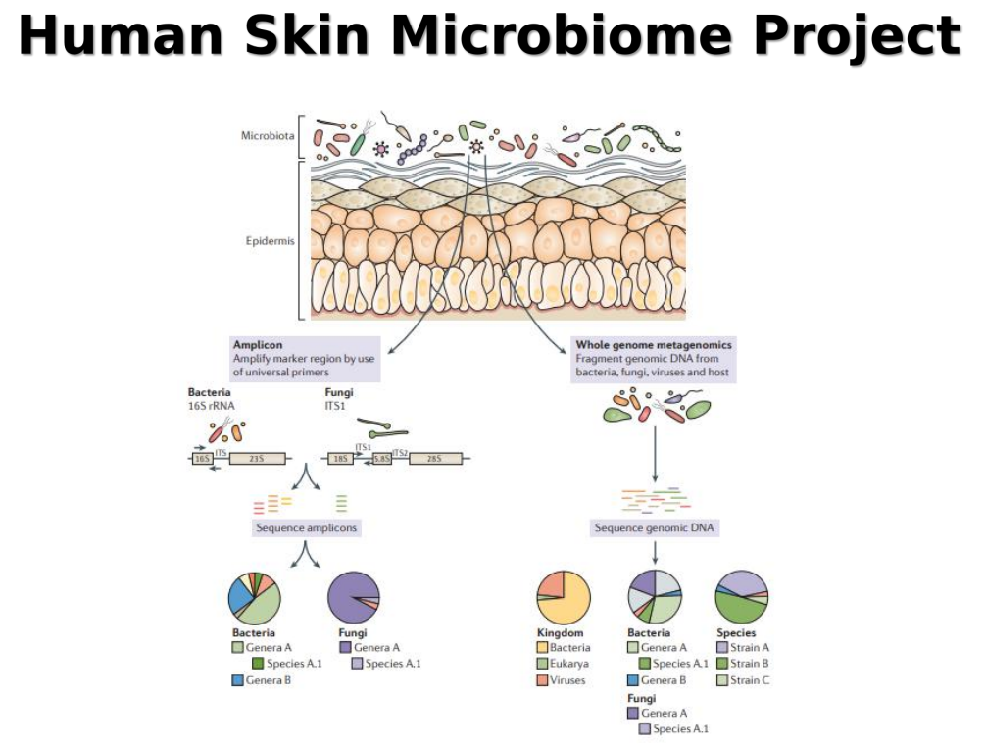

Slide 15

Host–microbiome dynamics in inflammatory bowel diseases
https://www.nature.com/articles/s41586-019-1238-8

Slide 16
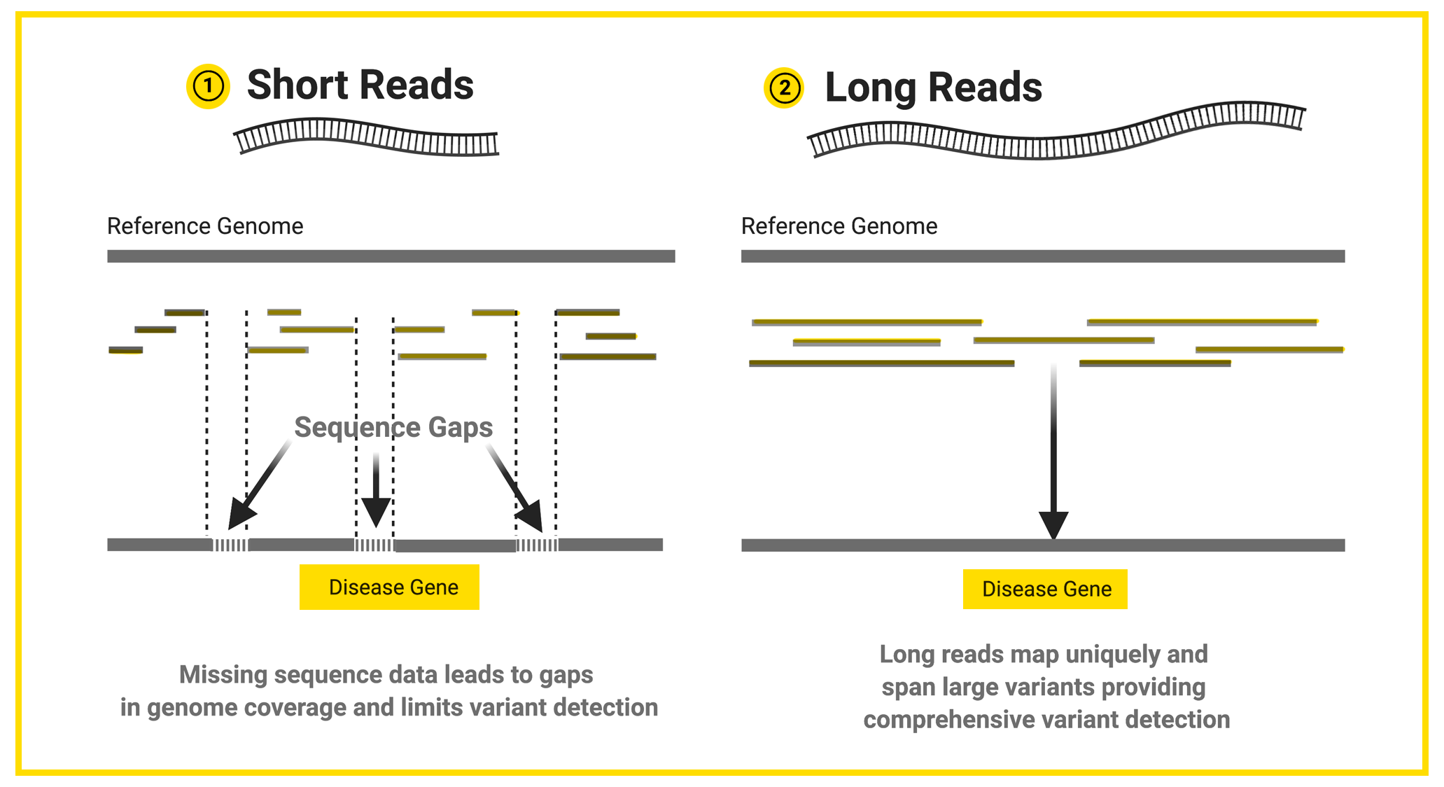
Short read vs Long read

Slide 17
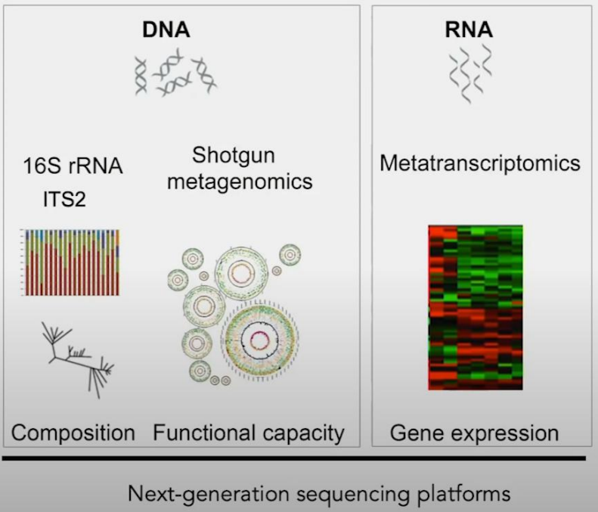
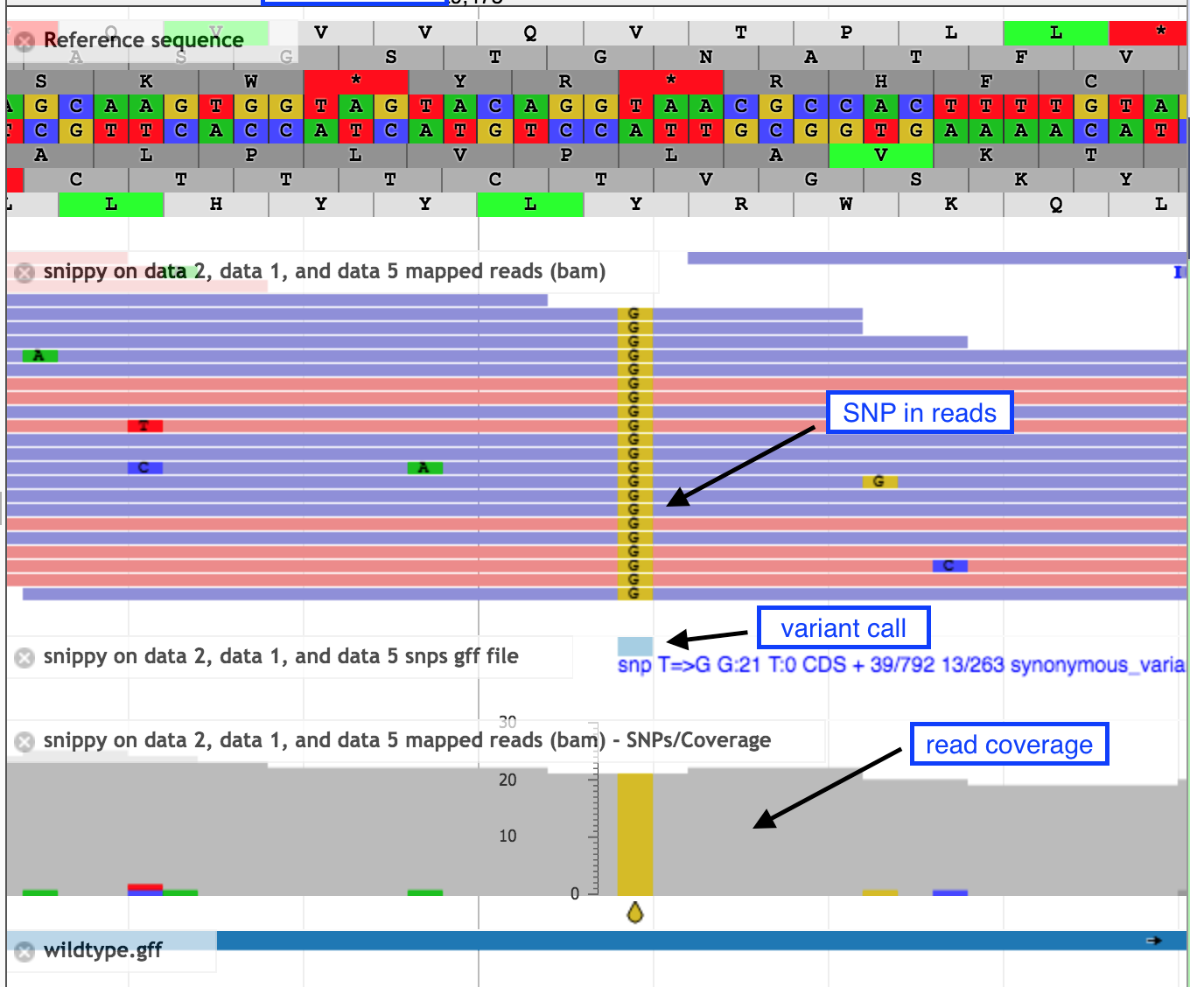
NGS Applications in microorganism research
Whole Genome Sequencing (WGS)

Slide 18
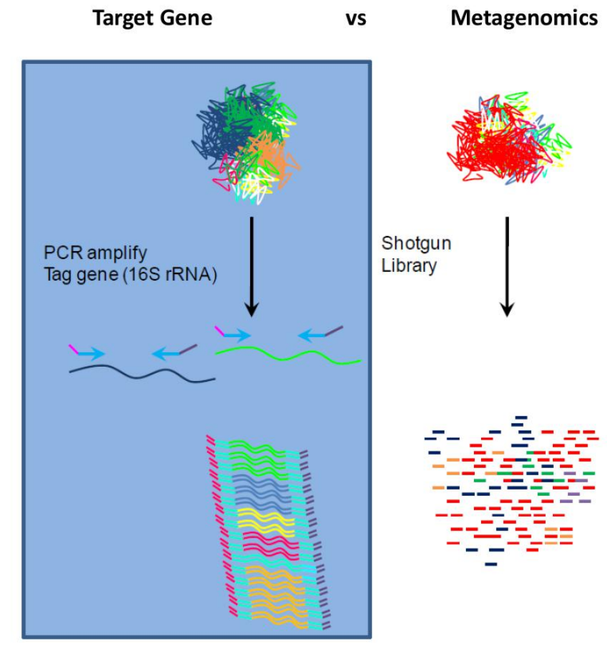
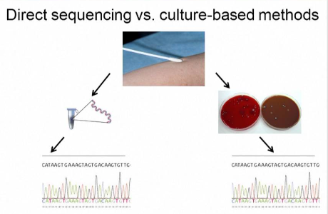

Slide 19
NGS Applications in microorganism research
DNA-seq:
Target sequencing (some genes): serotyping and genotyping
Whole Genome Sequencing (WGS): multi locus genotyping, genetic diversity and evolution study
Amplicon metagenomics (16S/ITS): identification/classification/ surveillance study
Shotgun metagenomics: resistome
RNA-seq:
Transcriptomics: gene expression for a isolate
Meta-transcriptomics: gene expression for a bulk sample
Single cell RNA-seq: gene expression for individual cells

Slide 20
Thank you for your attention!

